Slide 1


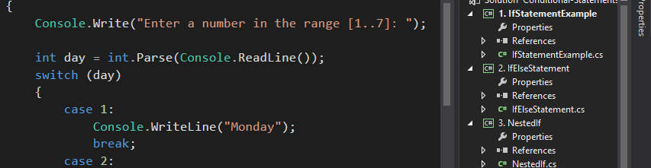
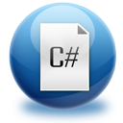
Advanced C#
Course Introduction
SoftUni Team
Technical Trainers
Software University
http://softuni.bg

Slide 2

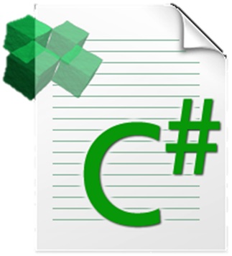
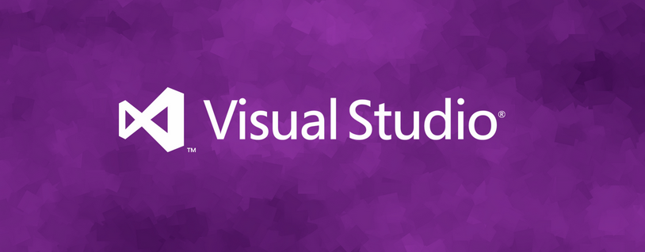
Table of Contents
Course Objectives
Course Program
Trainers Team
Examination
Learning Resources

Slide 3










SoftUni Diamond Partners

Slide 4


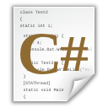
Advanced C# Course
C# Advanced
Course Objectives & Program

Slide 5
Course Objectives
The "Advanced C#" course:
Next steps in computer programming with C#:
Arrays, lists, multidimensional arrays, dictionaries, regex
Establish algorithmic thinking
Development of problems solving skills
Prepare for learning other languages and software technologies
Java, HTML, CSS, JavaScript, PHP
Databases & SQL, high-quality code
Web development technologies

Slide 6
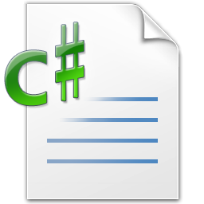
Advanced C# – Course Topics
Basic data structures – arrays, lists, dictionaries
Using methods
Working with strings and regular expressions
Streams and files overview
Functional programming basics
Asynchronous programming

Slide 7
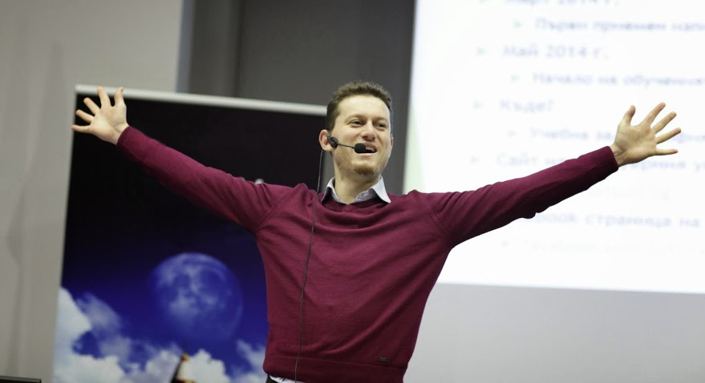
The Trainers Team

Slide 8
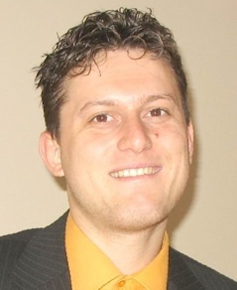
Trainers Team
Svetlin Nakov, PhD
Training & Inspiration Manager @ Software University
20+ years software development experience
10+ years experience as trainer
Author of 7 programming books
Speaker at hundreds of events
Web site & blog: www.nakov.com

Slide 9
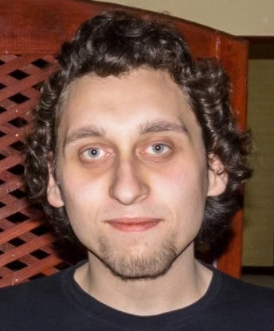
Trainers Team (2)
Yordan Darakchiev
Trainer @ Software University
Top performing graduate from the Software Academy (2013)
Top performing student at the Software University (2014)

Slide 10
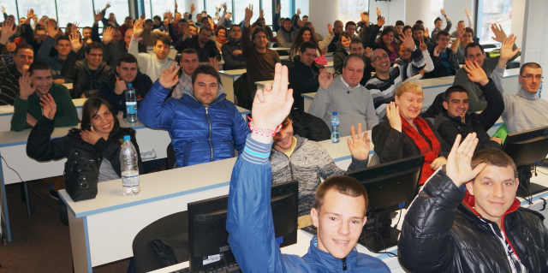

Volunteer Teaching Assistants
Volunteer teaching assistants
Top performers from previous SoftUni courses

Slide 11
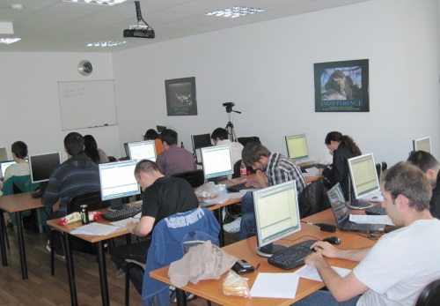

Advanced C# Course Details
Duration, Languages, Technologies

Slide 12


Training Duration – Programming Basics
Lectures: ~ 16 hours (onsite + YouTube videos)
Practical exercises (in class): ~ 6 hours
Homework: ~ 40+ hours
Lab + Exam Prep: ~ 12 hours
Exam: 6 hours
Allocation
Timeframe: September - October 2015
Exam: 11 October 2015

Slide 13
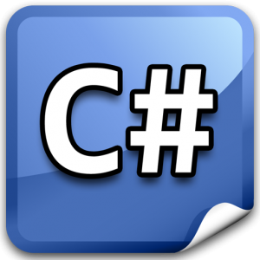


Why C# and .NET Framework?
C#, .NET and Visual Studio in Windows environment
Excellent start for beginners, very easy to learn
The C# language
Modern object-oriented language
Very popular, used by millions of developers
Easy to learn, yet very powerful
C# is just the start!
We will learn Java, PHP, Linux, HTML, JS, SQL, and many more

Slide 14


Why English?
Why the slides are in English?
English is the native language of the software engineers
Specific terminology should be in English
Translations are inaccurate and funny
Just learn English!
No excuses

Slide 15

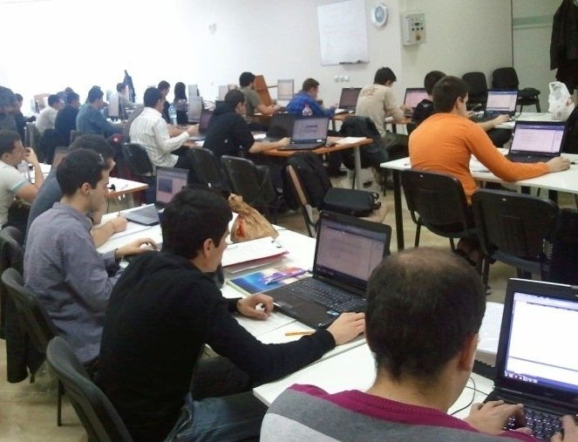
Advanced C#
Evaluation Criteria

Slide 16


Course Evaluation – Score System
Exam – 80%
Teamwork: 10%
Homework + evaluation – 5% + 5%
Bonuses: up to 10%
Presence in class: 5% (onsite students only)
Forum bonuses
Others

Slide 17

Teamwork Project

Slide 18
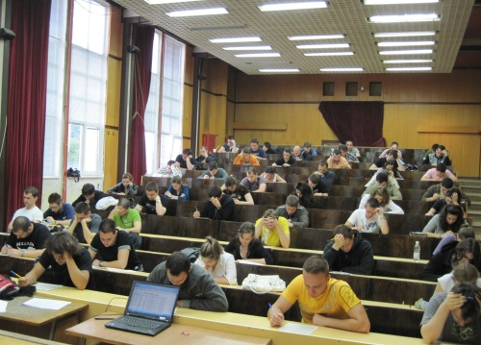

C# Advanced Exam
The practical programming exam explained
4 practical problems for 6 hours
1 arrays, 1 matrices, 1 strings, 1 hash-tables
Covers all topics studied up to the moment
Automated judge system & real-time feedback
Solutions are evaluated for correctness only
Code quality is still not measured

Slide 19

Homework Assignments
Doing your homework is very important!
Programming can only be learned through a lot of practice!
You should write code every day!
Each lecture is followed by a few exercises
Try to solve them in class
The rest are your homework
Homework assignments are due in 1 week after each lecture
Submission will be accepted through our web site: softuni.bg

Slide 20

Homework Peer Reviews
Everyone will give feedback to a few random homework submissions
Students submit homework anonymously
Please exclude your name from the submissions!
For each homework submitted
Students evaluate 3 random pieces of homework
From the same topic, in 3 days after the deadline
Give written feedback, at least 200 characters
Low-quality feedback → report for punishment
Everyone will get feedback for their homework

Slide 21









Resources
What We Need Additionally?

Slide 22

Course Web Site & Forums
The Programming Basics official web site:
Register for the "Software University Forum":
Discuss the course exercises with your colleagues
Find solutions for all course exercises
Share source code / discuss ideas / help each other
https://softuni.bg/courses/advanced-csharp
http://softuni.bg/forum

Slide 23



The Programming Basics Slides and Videos
All lecture slides, videos, homework assignments, projects and other resources are open content, available for free
Visit the course web site to access the course resources

Slide 24

The Free C# Fundamentals Textbook
The official textbook for the course
"Fundamentals of Computer Programming with C#", by Svetlin Nakov & Co., 2013, ISBN 9789544007737
English and Bulgarian versions (as PDF, ePub, …)
Freely downloadable from: www.introprogramming.info
The C# Programming courses @ SoftUni.bg mainly follow the book
Asynchronous programming is not covered in the book

Slide 25
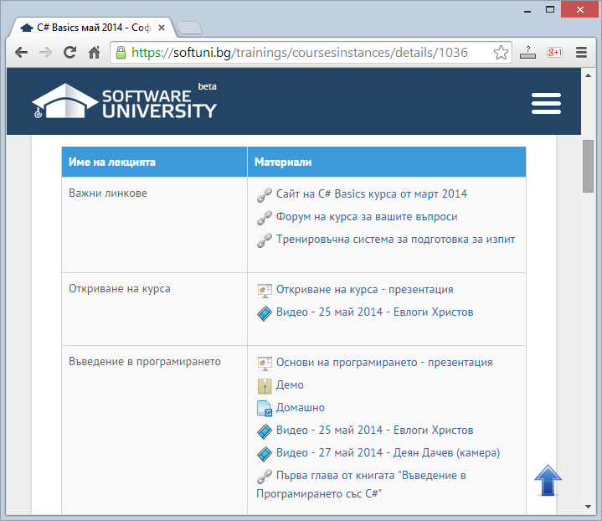
Software University Learning System (SULS)
Software University Learning System (SULS)
www.softuni.bg
Important resource for all students
Homework submissions
Homework check-up
Exams and results
Reports about your progress
…

Slide 26


Required Software
Software needed for this course:
Microsoft Windows (Win 10, Win 8.1 / Win8 / Win7 / Win XP)
Visual Studio Community 2015 (a free version of VS 2015)
Visual Studio 2013, 2012, 2010 are also acceptable
.NET Framework 4.6 (included in Visual Studio 2015)

Slide 27

Summary
The "Advanced C#" course
Continuation of Programming Basics
Training program
Data structures, asynchronous programming, LINQ, …
Practical exams
Automated judge system + score system
Learning resources
Lectures, videos, software, books, forum

Slide 28




Advanced C#
https://softuni.bg/courses/programming-basics/

Slide 29
SoftUni Diamond Partners

Slide 30
License
This course (slides, examples, demos, videos, homework, etc.) is licensed under the "Creative Commons Attribution-NonCommercial-ShareAlike 4.0 International" license
Attribution: this work may contain portions from
"Fundamentals of Computer Programming with C#" book by Svetlin Nakov & Co. under CC-BY-SA license
"C# Part I" course by Telerik Academy under CC-BY-NC-SA license
"C# Part II" course by Telerik Academy under CC-BY-NC-SA license

Slide 31





Free Trainings @ Software University
Software University Foundation – softuni.org
Software University – High-Quality Education, Profession and Job for Software Developers
softuni.bg
Software University @ Facebook
facebook.com/SoftwareUniversity
Software University @ YouTube
youtube.com/SoftwareUniversity
Software University Forums – forum.softuni.bg

